Slide 1









Effective Barangay Legislation
Ordinance
Policy
Presented by:
ATTY. ROLYNNE A. JAVIER, CESO V
Asst. Director, DILG-Bureau of Local Government Supervision

Slide 2
1.
1987 Philippine Constitution
Outline of Presentation
2.
Decentralization and Local Autonomy
Local Legislation
3.

Slide 3


The 1987 Philippine Constitution
This is the fundamental law of the land.

Slide 4





Section 1, Article II
The Philippines is a democratic and republican State. Sovereignty resides in the PEOPLE and all government authority emanates from them.
The 1987 Philippine Constitution

Slide 5
The prime duty of the Government is to SERVE and PROTECT the people.
The 1987 Philippine Constitution
Sec. 4, Art. II

Slide 6

The 1987
Philippine Constitution
Section 5, Article II
The maintenance of peace and order, the protection of life, liberty, and property, and promotion of the general welfare are essential for the enjoyment by all the people of the blessings of democracy.

Slide 7

Section 25, Article II
The State shall ensure the autonomy of local governments.
The 1987 Philippine Constitution
Two (2) facets:
Administrative
Fiscal

Slide 8
The Philippines is a republic with a presidential form of government wherein power is equally divided among its three branches: executive, legislative, and judicial. The government seeks to act in the best interests of its citizens through this system of check and balance.
01

Slide 9
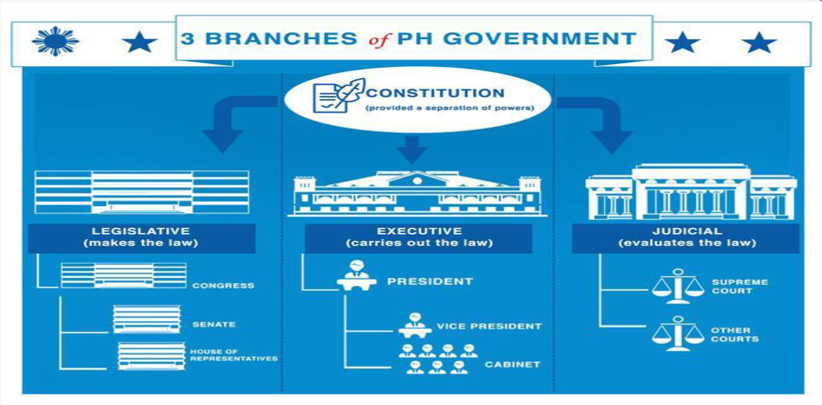
01.

Slide 10
President’s Power of General Supervision over LGUs
Consistent with the basic policy on local autonomy, the President shall exercise general supervision over LGUs to ensure that their acts are within the scope of their prescribed powers and functions.
Section 25, RA 7160

Slide 11
Power of Control
National Government
Power of General Supervision
LGUs
President’s Power
Power of Control
National Government
Power of General Supervision
Local Government Units
Department Secretaries – alter ego of the President
Doctrine of Qualified Political Agency

Slide 12
Enactment of RA 7160
LGUs to enjoy genuine and meaningful local autonomy
  Fullest development as self-reliant LGUs
Local autonomy
  Effective partners in the attainment of national goals
Self-reliant LGUs

Slide 13
Batangas CATV vs Court of Appeals
GR No. 138810 (Sept 29, 2004), En Banc
Local governments must be reminded that they merely form part of the whole. Thus, when the Drafters of the 1987 Constitution enunciated the policy of ensuring the autonomy of local governments, it was never their intention to create an imperium in imperio (empire within an empire) and install an intra-sovereign political subdivision independent of a single sovereign state

Slide 14
RA 7160
Book 1 – General Provisions
Book 2 – Local Taxation and Fiscal Matters
Book 3 – Local Government Units
Book 4 – Miscellaneous and Final Provisions

Slide 15
An LGU can exercise its powers within its territorial boundary or jurisdiction
It is a body politic and corporate endowed with powers to be exercised by it in conformity with law. As such, it shall exercise powers as a political subdivision of the national government and as a corporate entity representing the inhabitants of its territory
02
Decentralization
and Local Autonomy

Slide 16
Nature of LGUs
City of Manila vs IAC, GR No. 71159, Nov. 15, 1989
Governmental Powers are those exercised in administering the powers of the state and promoting the public welfare and they include the legislative, judicial, public and political
Municipal Powers on the one hand are exercised for the special benefit and advantage of the community and include those which are ministerial, private and corporate

Slide 17
Nature of LGUs
01
Section 16. General Welfare. - Every local government unit shall exercise the powers expressly granted, those necessarily implied therefrom, as well as powers necessary, appropriate, or incidental for its efficient and effective governance, and those which are essential to the promotion of the general welfare. xxx

Slide 18
Local Legislation
a required process whereby the sovereign through its legislative body authorizes/legitimizes the exercise of powers and use of resources for the general welfare
03

Slide 19
Legislative Agenda Formulation
Framework for Effective Local Legislation
Ordinances
Resolutions
Codes of Ordinances
Poverty Reduction
Gender Equality
Environmental Protection
Accountability Transparency
Citizen Participation
Executive Legislative Agenda
Evaluation of Implement ation of Ordinances
Crafting of Ordinances and Resolutions
LGU Vision and Mission
Enactment of Ordinances and Resolutions
  Organizational Structure
  Legislative Leadership
  Functional Committees
  Rules of Procedure
  Legislative Support System
  Apparatus for legislative-executive cooperation
Institutional Efficiency

Slide 20
Elements for Effective Local Legislation
Institutional Efficiency;
Local Legislation Cycle; and
Development

Slide 21
  Organizational Structure
  Legislative Leadership
  Functional Committees
  Rules of Procedure
  Legislative Support System
  Apparatus for legislative-executive cooperation
Institutional Efficiency

Slide 22

Local Legislative Process
Legislation is a required process whereby the sovereign through its legislative body authorizes/legitimizes the exercise of powers and use of resources for the general welfare

Slide 23
Ordinance - legislative action of a general and permanent character
Resolution - mere expression of legislative sentiment. Temporary in character.
Legislative Outputs

Slide 24
Ordinance | Resolution
As to Effect
Effect of a law; Prescribes a permanent rule of conduct | Declaration of sentiment or opinion of a lawmaking body on a specific matter
As to Character
General and permanent character | Temporary in nature
As to Procedural Requirements
Requires a third reading | Does not require a third reading

Slide 25
Sanggunian | Penalties imposable
Sangguniang Barangay | Not more than P1,000.
Sangguniang Bayan | Not more than P2,500.00 or an imprisonment for a period not exceeding six (6) months or both in the discretion of the court
Sangguniang Panlungsod/ Panlalawigan | Not more than P5,000.00 or imprisonment for a period not exceeding 1 year or both, at the discretion of the court
PENALTIES

Slide 26
?
Why
am I here

Slide 27
HOW AN IDEA BECOMES AN ORDINANCE
SOURCES OF IDEA
National Laws
Campaign Promises
Felt Needs
Amendment or repeal of existing ordinances
Review or evaluation of programs/projects
Interest/lobby groups
Oversight Report
Others

Slide 28
HOW AN IDEA BECOMES AN ORDINANCE
SOURCES OF IDEA
SB/SP MEMBER
SECRETARY TO THE SANGGUNIAN
SECOND READING
FIRST READING
COMMITTEE
THIRD READING
ENROLMENT
LCE
Secretary prepares the measure duly certified by the Presiding Officer and transmits to the LCE for his consideration

Slide 29
Signs measure
Overrides the veto action by 2/3 vote of all members
LCE
SB/SP ACTION
Vetoes
After 10 days without signature
No further action
HOW AN IDEA BECOMES AN ORDINANCE
Sec. 55 (b) The veto shall be communicated by the local chief executive concerned to the Sanggunian within fifteen (15) days in the case of a province, and ten (10) days in the case of a city or a municipality; otherwise, the ordinance shall be deemed approved as if he had signed it.

Slide 30
HOW AN IDEA BECOMES AN ORDINANCE
SOURCES OF IDEA
SB/SP MEMBER
SECRETARY TO THE SANGGUNIAN
SECOND READING
COMMITTEE
FIRST READING
THIRD READING
ENROLMENT
LCE
ARCHIVE
SECRETARY TO THE SANGGUNIAN
SB/SP ACTION

Slide 31
Review of Barangay Ordinances by the Sangguniang Panlungsod or Sangguniang Bayan (Sec. 57)
Within ten (10) days after its enactment, the Sangguniang Barangay shall furnish copies of all Barangay ordinances to the Sangguniang Panlungsod or Sangguniang bayan concerned for review as to whether the ordinance is consistent with law and city or municipal ordinances.
If the Sangguniang Panlungsod or Sangguniang bayan, as the case may be, fails to take action on Barangay ordinances within thirty (30) days from receipt thereof, the same shall be deemed approved.

Slide 32
Review of Barangay Ordinances by the Sangguniang Panlungsod or Sangguniang Bayan (Sec. 57)
If the Sangguniang Panlungsod or Sangguniang bayan, as the case may be, finds the Barangay ordinances inconsistent with law or city or municipal ordinances, the Sanggunian concerned shall, within thirty (30) days from receipt thereof, return the same with its comments and recommendations to the Sangguniang Barangay concerned for adjustment, amendment, or modification; in which case, the effectivity of the Barangay ordinance is suspended until such time as the revision called for is effected.

Slide 33
Effectivity of Ordinances or Resolutions (Sec. 59)
General Rule:
Shall take effect after ten (10) days from the date a copy thereof is posted in a bulletin board at the entrance of the provincial capitol or city, municipal, or brgy. hall, as the case may be, and in at least two (2) other conspicuous places in the LGU concerned
Exception:
Unless otherwise stated in the ordinance or the resolution approving the local development plan and public investment program

Slide 34
Section 332. Effectivity of Barangay Budgets. - The ordinance enacting the annual budget shall take effect at the beginning of the ensuing calendar year. An ordinance enacting a supplemental budget, however, shall take effect upon its approval or on the date fixed therein.
The responsibility for the execution of the annual and supplemental budgets and the accountability therefor shall be vested primarily in the punong barangay concerned
03

Slide 35
(a) Within ten (10) days from its approval, copies of the barangay ordinance authorizing the annual appropriations shall be furnished the sangguniang panlungsod or the sangguniang bayan, as the case may be, through the city or municipal budget officer. The sanggunian concerned shall have the power to review such ordinance in order to ensure that the provisions of this Title are complied with. If within sixty (60) days after the receipt of the ordinance, the sanggunian concerned takes no action thereon, the same shall continue to be in full force and effect.
03
Review of the Barangay Budget

Slide 36
?
Why
am I here

Slide 37
“You create your own universe as you go along.“
- Winston Churchill

Slide 38
“From everyone who has been given much, much will be demanded; and from the one who has been entrusted with much, much more will be asked.”
Luke 12:48

Slide 39
Thank you!
ATTY. ROLYNNE A. JAVIER, CESO V
Assistant Director, DILG-BLGS

